Slide 1
Operating system Lecture seven part1
Dr jamal altuwaijari

Slide 2
7. Deadlocks
- A C/S consist of a finite number of resources to be distributed among a number of competing processes.
The resources are partitioned into several types, each of which consists of some number of identical instances memory, CPU, cycles, files, and I/O devices (L/P, C/R, Disk, ....) arc examples of resource types.
Under the normal operation of C/S , a process may utilize a resource in only the following sequence:
a. Request: If the request can not be granted immediately then the requesting process must wait until it can acquire the resource.
b. User : The process can operate on the resource (if the resource is a L/P the process can print on L/P).
c. Release: The process releases the resource.

Slide 3
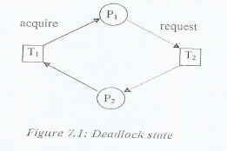
7.1 Deadlocks definition
A. set of processes is in a deadlocks state when every process in the set is waiting for an event that can only be caused by another process in the set.
Example:-
Consider a C/S with two tape drives, suppose that there or two processes each holding one of these tape drives. If each process now requests another tape drive, the two processes will be in a deadlock state, see the figure below.

Slide 4
7.2 Deadlock Necessary conditions
In a deadlock , processes never finish executing and system resources are tied up, preventing other processes from ever starting.
A deadlock situation can arise if and only if the following four conditions hold simultaneously in a system. These conditions are :-
Mutual Exclusion
At least one resource is held in a non-sharable mode that is only one process at a time can use the resource. If another process requests that resource the requesting process must be delayed until the resource has been released.
Hold and Wait
There must exist a process that is holding at least one resource and is waiting to acquire
Additional resources are currently being held by other processes.
No Preemption
Resources can not be preempted; that is a resource can be released only voluntarily by the process holding after that process has completed its task.

Slide 5
7.2 Deadlock Necessary conditions
Circular Wait
There must exist a set {P₀, P₁, ……., P_{n} } of waiting processes such that P₀ is waiting processes such that P₀ is waiting for a resource that is held by P₁, P₁ is waiting for a resource that is held by P₂ , ……, P_{N-1} is waiting for a resource that is held by P_{n} , and P_{n} is waiting for a resource that is held by P₀.

Slide 6
7.3 Resources-Allocation Graph (RAG)
Deadlocks can be described more precisely in terms of a directed graph called (RAG).
RAG = (V,E) where V is a set of vertices and E is a set of edges .
P {p₁, p­₂, …., p_{n}} set of processes
V R {r₁,r₂,……,r_{n}} set of processes
Each element in the set E of edges is an ordered pair (p_{i}, r_{j}) or (r_{j,} p_{i}) where p_{i} is an a process (p_{i} ∈ P)and
r_{j} is a resource type (r_{j} ∈ R) .

Slide 7
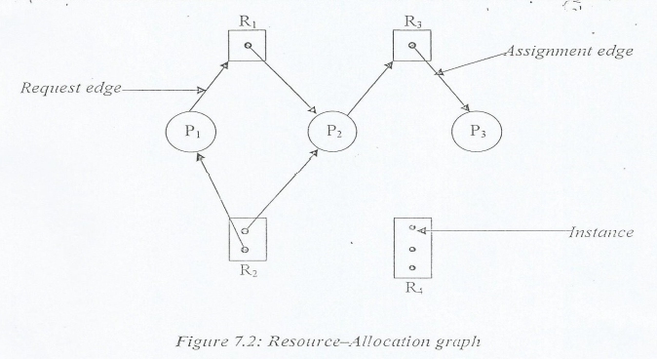
7.3 Resources-Allocation Graph (RAG)
Graphically we represent each process p_{i} as a circle and each resource type R_{j} as a square. Since resource type R_{j} may have more than one instance we represent each such instance as a dot within a square, see figure 7.2 below.

Slide 8
7.3 Resources-Allocation Graph (RAG)
The RAG in this figure depicts the following situation.
A- The sets P,R and R
- P={p₁ , p₂ , p₃}
- R={r₁ , r₂ , r₃}
- E={(p₁ , r₁) , (p₂ , r₃) , (r₁ , p₃) , (r₂ , p₂) , (r₂ , p₁) , (r₃ , p₃)}
B- Resource instances:
- R₁=1,R₂=2,R₃=3 and R₄=4 instances.
C- Process states:
P₁ r₁ , P₂ r₃ , r₁ p₂ , r₂ p₁ , r₂ p₂ , r₃ p₃

Slide 9
7.3 Resources-Allocation Graph (RAG)
By using a RAG it can be easily shown that if the graph contain no cycles, than no process in the system is deadlocked . If on the other hand the graph contains a cycle then a deadlock may exist .
If each resource type has exactly one instance then a cycle implies that a deadlock has occurred . If the cycle involves only a set of resource types each of which has only a single instance then a deadlock has occurred.
Each process involved in the cycle is deadlocked.
In this case a cycle in the graph is both a necessary and a sufficient condition for the existence of
Deadlock.
If each resource type has several instances then a cycle does not necessarily imply that a deadlock occurred. In this case a cycle in the graph is a necessary but not a sufficient condition for the existence of deadlock.
To illustrate this concept let us return to figure 7.2 suppose that p₃ requests r₂ . Since no resource instance is currently available a request edge p₃—> r₂ is added to the graph figure 7.3. At this point two minimal cycles exist in the system:
p₁ —> r₁—> p₂ —> r₃ —> p₃ —>r₂ —>p ₁
p₂ —> r₃ —> p₃ —>r₂ —>p₂
processes p₁, p₂, and p₃ are deadlocked.

Slide 10
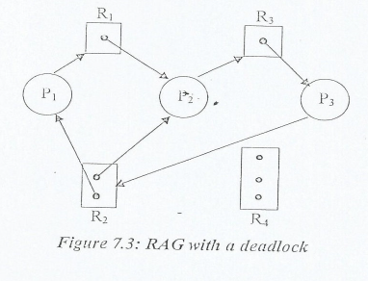
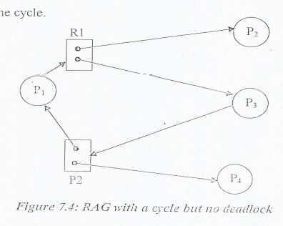
7.3 Resources-Allocation Graph (RAG)
In the figure 7.4 below we have a cycle. but there is no deadlock. P₁—> r₁—> p₃ —> r₂ —>p_{1.}
Where p₄ way release its instance of R₂ that source can then be allocated to p₃ breaking the cycle.

Slide 11
7.4 Methods for Handling Deadlocks
There are three methods for dealing with the deadlock problem:
We can use a protocol to ensure the s) stem will never enter a deadlock state.
Allow the system to enter a deadlock state and then recover.
We can ignore the problem all togather and pretend that deadlocks never occur in the system.
To ensure that a deadlocks never occur the system can use either a deadlock—prevention or a deadlock—avoidance scheme.

Slide 12
7.4.1 Deadlock prevention
It is a set of methods for ensuring that at least one of the necessary conditions can not hold. These method's prevent deadlocks by constraining how requests for resources can be made.
The mutual—exclusion condition must hold for non—sharable resource, sharable resources on the other hand do not require mutually exclusive access.
To ensure that the hold—and—wait condition never occurs in the system must guarantee that whenever a process request a resource it does not hold any other resources. This can be implemented by:
1- Allocate all resources to process before its execution.
2- A process request a resource only allowed when it has none. The problems with this the low utilization of resource usage and starvation.
* No—preemption
If a process that is holding some resources request another resources that can not allocated to it then all resources currently being held are preempted.
* Circular wait
Let R ={R₁ , R₂ , ...., R_{m}} be the set of resource types we can assign to each type a number which allow us to compare two resource. If we define a one—to—one function F: R —> N where N is the set of numbers.

Slide 13
7.4.1 Deadlock prevention
Example:
F (T/ Drive) = 1
F (Disk/ Drive) = 5
F.(Printer) = 12
Each process can request resources only in an increasing order of enumeration. That is process can initially request any number of instances of R₁ after that the process can request instances of resource type R_{j} if and only if F(R_{j}) > F (R_{J}).

Slide 14
7.4.2 Deadlock Avoidance
For avoiding deadlock is to require additional information about how resources are to be requested.
For example in a C/S with one tape and one printer we might be told that process p will request first m/t and later L/P before releasing both resources.
Process Q on the other hand will request first the printer and then the M/T. With this knowledge of the complete sequence of request and releases for each process we can decide for each request whether or not the process should wait.
Each request requires that then consider the following:
1. The resources currently available.
2. The resources currently allocated to each process.
3. The future requests and releases of each process.

Slide 15
7.4.2 Deadlock Avoidance
The above information used to decide whether the current request can be satisfied or must wait to avoid a possible future deadlock.
The various algorithms differ in the amount and type of information required. The simplest and most useful model requires that each process declare the maximum number of each type that it may need.
A deadlock avoidance algorithm dynamically examines the resource—allocation state to ensure that these can never be a circular—wait condition.
The resource allocation state is defined by the number of available and allocated resources and the maximum demands of the processes.

Slide 16
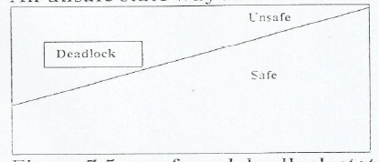
- Safe state
A state is safe if the system can allocate resources to each process (up to maximum) in some order and still avoid a deadlock.
A safe state is not a deadlock state , and a deadlock state is an unsafe state. but not all unsafe states are deadlock . An unsafe state way lead to a deadlock.
Figure 7.5 unsafe and deadlock state spaces.

Slide 17
Example:- To illustrate consider a system with 12 w\T and 3 process :
P₀ , P₁ and P₂ .The maximum needs and current needs for each process as indicated below
(Allocate)
At time the system is in a safe state. The sequence <P1,P0,P2>.
Suppose that at time t₁ process P₂ requests and is allocated 1 move tape drive. the system is no loner in safe state . At this point only process P₁ can be allocated all its tape drives. When it returns thew the system have only if available and this number not satisfy the request for P₀ or P₂ therefore
P0 P2 P0
 | Maximum needs | Current needs | available
P0 | 10 | 5 | 3
P1 | 4 | 2
P2 | 9 | 2
WAIT
WAIT

Slide 18
If we had made P₂ wait until either of the order process had finished and released its resources then we could have avoided the deadlock situation.
There are many deadlock avoidance algorithms, some of these are :

Slide 19
A- ARG Algorithm
If we have a RAG system with only One instance of each resource type. In addition to the request and assignment edges we introduce a new type of edge called a claim edge P_{i} —>R_{j} indicates that process P_{i} may request resource R_{j} at some time in the future. It is as a request edge in direction but is represented by a dashed line when process P_{i} request resource R_{j} the claim edge P_{i} --> R_{j} is converted to a request edge. When a resource R_{j} is released by P_{i} the assignment edge R_{j} --> P_{i} is reconverted to a claim edge P_{i} --> R_{j} .
To illustrate this algorithm consider the RAG in figure 7.6 suppose that P₂ requests r₂ . Although r₂ is currently free we can not allocate it to P₂ since this action will create a cycle in the graph figure 7.7. A cycle indicates that the system is in an unsafe state. If P₁ then requests r₂ a deadlock will occur.

Slide 20
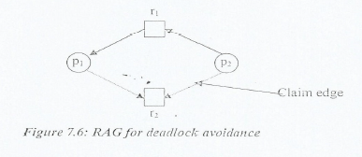
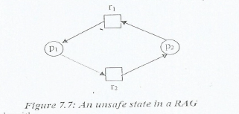
A- ARG Algorithm

Slide 21
B- Banker's Algorithm
This Alg. could be used in a banking system to ensure that the bank never allocates its available cash in such a way that it can no longer satisfy the needs of all its customers.
When a new a process enters the system it must declare the maximum number of instances of each resource type that it may need.
- The maximum must be 5 total number of resources in the system.
- When a user requests a set of resources must be leave the system in a safe state if the resources are allocated otherwise the process must wait until some Other process releases enough resources.
Several data structures must be maintained to implement banker's algorithm.
Let n be the number of processes in the system and m be the number of resource types. We need the following data structures:
* Available: A vector of length m indicates the number of available resources of each type.

